Slide 1
Sorting
Fall 2024
School of Software Engineering
South China University of Technology

Slide 2

“Linear-Time” Sorts

Slide 3
Bucket Sort
for (i=0; i<n; i++)
B[A[i]] = A[i];
Bucket Sort
The key values are used to determine the positions for the records in the final sorted array.
It works only for a permutation of the numbers from 0 to N-1.
The cost is Θ(N) time regardless of the initial ordering of the keys.
A: 4 2 3 1 0
B: 0 1 2 3 4

Slide 4
Bucket Sort
/**
* Bucket Sort
* Allow for duplicate values among keys
* Allow for a set of N records falling in a range larger
* than N ([0,MaxKeyValue-1])
**/
template <typename E, class getKey>
void bucketsort(E A[], int n) {
List<E> B[MaxKeyValue]; //An array of linked lists
E item;
//assign records to bins
for (i=0; i<n; i++)
//All records with key value i are placed in bin B[i]
B[getKey::key(A[i])].append(getKey::key(A[i]));
//process MaxKeyValue bins to output records
for (i=0; i<MaxKeyValue; i++)
for (B[i].setStart(); B[i].getValue(item); B[i].next())
output(item);
}

Slide 5
Bucket Sort
The time cost consists of
Θ(N) for assigning N records to buckets.
Scan MaxKeyValue buckets to output N records
If MaxKeyValue is Θ(N), the total cost is Θ(N);
If MaxKeyValue is Θ(N²), the total cost becomes Θ(N+N²)=Θ(N²);
A large key range requires an unacceptably large array B.
Useful only for a limited key range.

Slide 6
Bucket Sort
A further generalization
Each bucket is associated with a range of key values, instead of a single key value
A bucket sort assigns records to buckets and then relies on some other sorting technique to sort the records within each bucket.
A small number of records will be put in each bucket by relatively inexpensive bucketing process
A cleanup sort within the bucket will be relatively cheap.

Slide 7
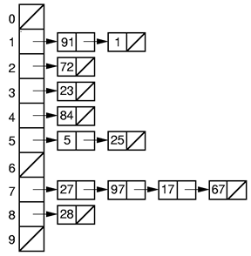
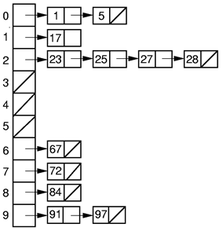
Bucket Sort
Consider a sequence of records with keys in the range 0 to 99
27,91,1,97,17,23,84,28,72,5,67,25
There are 10 buckets available
We can assign records to buckets by taking key%10.
B[A[i]%10]
B[A[i]/10]
91,1,72,23,84,5,25,27,97,17,67,28
1,5,17,23,25,27,28,67,72,84,91,97

Slide 8
Bucket Sort
In the previous example,
There are b=10 buckets and N=12 keys;
The key values are in the range of 0 to b²-1;
The records are assigned to buckets based on the keys’ digit values working from the rightmost digit to the leftmost.
Round 1: the bin number is B[A[i]%10]
Round 2: the bin number is B[A[i]/10]
Finally, the records are taken from the buckets in order which produces a sorted list
The time cost is Θ(N).

Slide 9
Radix Sort
Radix Sort – assign records to buckets with the buckets computed based on the radix or the base of the key values
It would work for any number of buckets
base = 10, 2, 8, 16, …
It can be extended to any number of keys in any key range
Assign records to buckets based on the keys’ digit values working from the rightmost digit to the leftmost.

Slide 10
Radix Sort
Example: the number of buckets is 8, and a key is 999
Round 1: 999%8 = 7, key 999 -> bucket 7
Round 2: (999/8)%8 = 4, key 999 -> bucket 4
Round 3: (999/8²)%8 = 7, key 999 -> bucket 7
Round 4: (999/8³)%8 = 1, key 999 -> bucket 1
Convert 999 to an octal number: 999 = 1*8³+7*8²+4*8+7 = 0x1747
Convert MaxKeyValue to a number with b(number of buckets) as the base
If the converted MaxKeyValue has r digits, all the keys are assigned to buckets r times
Keys are taken from the buckets in order and reassign to the buckets for the next round.
The running time is O(r(N + b))
r is the number of passes,
N is the number of elements to sort,
b is the number of buckets.

Slide 12
Radix Sort
/*
* Radix sort an array of Strings.
* Assume all characters are ASCII, residing in the first 256
* positions of the Unicode character set.
* Assume all have same length(stringLen).
*/
void radixSortA( vector<string> & arr, int stringLen ){
const int BUCKETS = 256;
vector<vector<string>> buckets( BUCKETS );
for( int pos = stringLen - 1; pos >= 0; --pos ){
for( string & s : arr )
//Adds s at the end of the buckets[ s[ pos ] ]
buckets[ s[ pos ] ].push_back( std::move( s ) );
int idx = 0;
for( auto & thisBucket : buckets ){
for( string & s : thisBucket )
arr[ idx++ ] = std::move( s );
thisBucket.clear( );
}
}
}

Slide 13
Radix Sort
How to implement the Radix Sort efficiently?
The number of keys assigned to a bucket can be greater than one and may be as large as the total number of keys
Let a bucket points to an array with size equal to the number of keys?
Let a bucket points to a linked list of keys?
Neither is good!
The total number of keys in all the buckets is known!
Reserve an array with the size of the total number of keys
Get to know the number of keys in each bucket
Bin 0 Bin 1 Bin 2 ………… Bin (r-1)

Slide 14
Radix Sort (V)
/*
* Counting radix sort
* B[] is array for buckets
* cnt[i] stores numbers of records in bucket[i]
* b is numbers of buckets(base), r is number of passes
*/
template <typename E, typename getKey>
void radix(E A[], E B[], int n, int r, int b, int cnt[]) {
int j;
for (int i=0, btoi=1; i<r; i++, btoi*=b) {//for r digits
for (j=0; j<b; j++) cnt[j] = 0;
//Count # of records for each buckets on this pass
for(j=0; j<n; j++) cnt[(getKey::key(A[j])/btoi)%b]++;
//Index B: cnt[j] will be index for last slot of bucket j.
for (j=1; j<b; j++) cnt[j] += cnt[j-1] ;
/*Put records into buckets, from bottom of each bucket.*/
for (j=n-1; j>=0; j--)
B[--cnt[(getKey::key(A[j])/btoi)%b]] = A[j];
for (j=0; j<n; j++) A[j] = B[j]; //Copy B back to A.
}
}

Slide 15


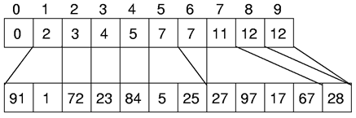

Radix Sort
Array A[]
Count in 1st pass
Index positions for B[]
Array A[] in the end of 1st pass
B[--cnt[(getKey::key(A[j])/btoi)%b]] = A[j];

Slide 16

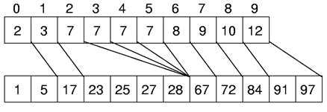

Radix Sort
Array A[] in the end of 1st pass
Count in 2nd pass
Index positions for B[]
Array A[] in the end of 2st pass
B[--cnt[(getKey::key(A[j])/btoi)%b]] = A[j];

Slide 17
Radix Sort
Time complexity analysis
It requires r passes over the list of N numbers in base b, with Θ (N + b) work done at each pass
The total cost is Θ (r(N + b))
How do r, b, and N relate?
The base b is usually a small number.
e.g. 2 or 10 for numbers; 26 for character strings
A minimum of log_{b}N digits are needed to represent N distinct key values,
If there are N unique keys, r is in Ω(log N)
The asymptotic complexity of Radix Sort is Ω(Nlog N).
Radix Sort is stable, not “In-place”

Slide 18
Homework 5-3
To Implement all sorting algorithms discussed. (The mission is not homework.)
According to the Radix sorting algorithm for variable-length strings in textbook Figure 7.27, show the sorting process for the input “We, can, extend, either, version, of, radix, sort, to, work, with, variable, length, strings”.
Deadline: to be confirmed.

